Slide 1
Chapter 3
FORWARD AND FUTURES PRICING
Notes:
(10 hours)

Slide 2
1. Forward price
1.1. Assumption and notation
1.2. Forward price for an investment asset
1.3. Valuing a forward contract
  1.4. Are forward prices and futures prices equal?
  2. Some specific forward/futures contracts
  2.1. Futures on stock indices
  2.2. Forward and futures contract on currencies
  2.3. Futures on commodities

Slide 3
Assumptions and notation
The market participants are subject to no transaction costs when they trade.
The market participants are subject to the same tax rate on all net trading profits.
The market participants can borrow money at the same risk-free rate of interest as they can lend money.
The market participants take advantage of arbitrage opportunities as they occur.

Slide 4
Notation
S₀: | Spot price today
F₀: | Futures or forward price today
T: | Time until delivery date
r: | Risk-free interest rate for maturity T

Slide 5
Consumption vs Investment Assets
Investment assets are assets held by significant numbers of people purely for investment purposes (Examples: gold, silver)
Consumption assets are assets held primarily for consumption (Examples: copper, oil)

Slide 6
Short Selling
Short selling involves selling securities you do not own
Your broker borrows the securities from another client and sells them in the market in the usual way

Slide 7
Short Selling
(continued)
At some stage you must buy the securities back so they can be replaced in the account of the client
You must pay dividends and other benefits the owner of the securities receives

Slide 8
Arbitrage = no cost & positive CF
The simultaneous buying and selling of securities, currency, or commodities in different markets or in derivative forms in order to take advantage of differing prices for the same asset. (Oxford Dictionary)
An arbitrage is a transaction that involves no negative cash flow at any probabilistic or temporal state and a positive cash flow in at least one state; in simple terms, it is the possibility of a risk-free profit at zero cost.

Slide 9
  Forward price for an investment asset
  Example (a): Consider a long forward contract to purchase a non-dividend-paying stock in 3 months. The current stock price is $40 and the 3-month risk-free interest rate is 5% per annum. The forward price is relatively high at $43. What arbitrage opportunities does this create?

Slide 10
Example (c)
Suppose that the forward price is $39.
What arbitrage opportunities does this create?

Slide 11
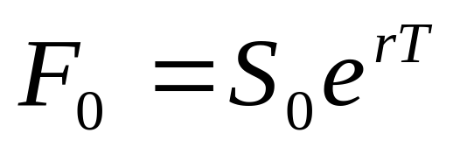
A generalization
Forward price:
This equation relates the forward price and the spot price for any investment asset that provides no income and has no storage costs

Slide 12
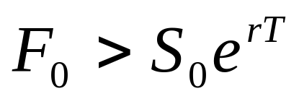
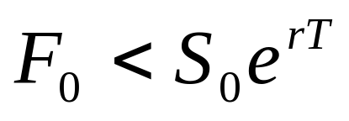
A generalization (b)
Forward price:
If → arbitrageurs can borrow money, buy the asset and short forward contracts on the asset.
If → arbitrageurs can short the asset, invest in the risk-free asset and enter into long forward contracts on the asset.

Slide 13
Problems
1. Suppose that you enter into a 6-month forward contract on a non-dividend-paying stock when the stock price is $30 and the risk-free interest rate (with continuous compounding) is 12% per annum. What is the forward price?

Slide 14
When an Investment Asset Provides a Known Dollar Income
Example: Consider along forward contract to purchase a coupon-bearing bond whose current price is $900 . The forward contract matures in 9 months. A coupon payment of $40 is expected after 4 months. The 4-month and 9-month risk free interest rates (continuously compounded) are 3% and 4%, respectively. The forward price is relatively high at $910. What arbitrage opportunities does this create?

Slide 15
Suppose that the forward price is relatively low at $870. An arbitrageur can:
→ Short the bond.
→ Enter into a forward contract to buy the bond in 9 months for $870.

Slide 16
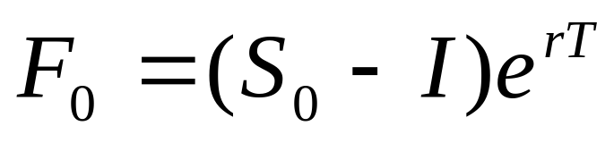
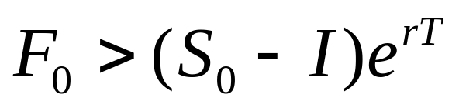
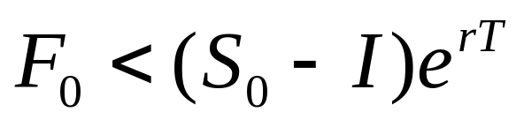
Known Income- A generalization
Where I is the present value of the income during life of forward contract.
If → buy the asset and short the forward contract.
If → short the asset and take a long position in the forward contract.

Slide 17
Example: Consider a 10-month forward contract on a stock when the stock price is $50. We assume that the risk-free rate of interest (continuously compounded) is 8% per annum for all maturities. We also assume that dividends of $0.75 per share are expected after 3 months, 6 months, and 9 months. What is the forward price?

Slide 18
When an Investment Asset Provides a Known Yield
F₀ = S₀ e^{(r–q )T}
where q is the average yield during the life of the contract (expressed with continuous compounding)

Slide 19
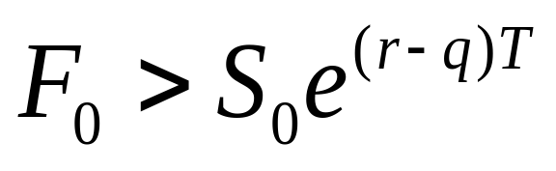
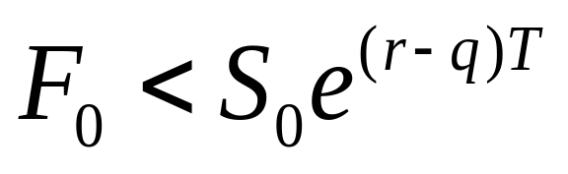
If an arbitrageur can buy the asset and short the forward contract.
If an arbitrageur can short the asset and take a long position in the forward contract.

Slide 20
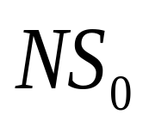
If
Method 1: Action now, at time 0:
Borrow
Buy N units of the assets and invest the income from the asset in the asset
Enter into a forward contract to sell the asset for F₀ per unit at time T.
Notes:
.

Slide 21
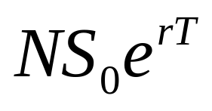
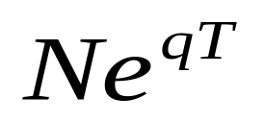
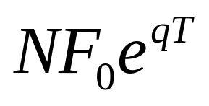
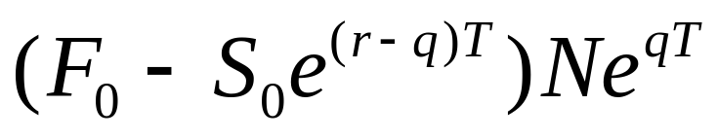
Action at time T
Repay the loan:
The income from the asset causes our holding in the asset to grow at a continuously compounded rate q. By time T, our holding has grown to units of asset.
Sell the asset for F0:
Net cash flow at time T:

Slide 22
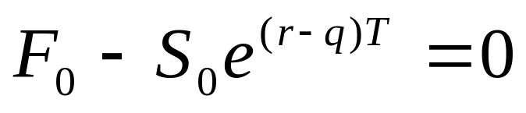
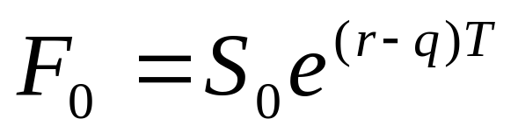
At time T
If there are no arbitrate opportunities then the forward price must be
Or
Where q is the average yield during the life of the contract (expressed with continuous compounding)

Slide 23
If an arbitrageur can buy the asset and short the forward contract.
If an arbitrageur can short the asset and take a long position in the forward contract.

Slide 24
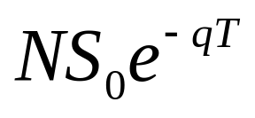
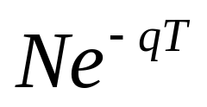
If
Method 2: Action now, at time 0:
Borrow
Buy units of the assets and invest the income from the asset in the asset
Enter into a forward contract to sell the asset for F₀ per unit at time T.

Slide 25
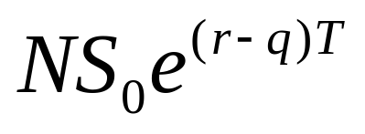
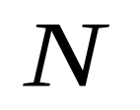
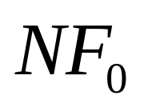
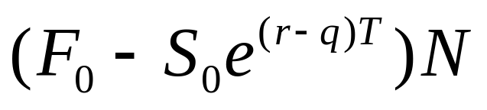
Action at time T
Repay the loan:
The income from the asset causes our holding in the asset to grow at a continuously compounded rate q. By time T, our holding has grown to units of asset.
Sell the asset for F0:
Net cash flow at time T:

Slide 26
At time T
If there are no arbitrate opportunities then the forward price must be:
Or
Where q is the average yield during the life of the contract (expressed with continuous compounding)

Slide 27
Ex: Consider a 6-month forward contract on an asset that is expected to provide income equal to 2% of the asset price once during a 6-month period. The risk-free rate (continuously compounding) is 10% per annum. The asset price is $25 and the forward contract is $30. What should an arbitrageur do?
→ S₀=25, r=0.10, T=0.5, simple yield = 2% → continuous yield: q= 2 ln(1+ 0.02) =0.0396

Slide 28
Problems
2. Suppose that you enter into a 6-month forward contract on a non-dividend-paying stock when the stock price is $30 and the risk-free interest rate (with continuous compounding) is 12% per annum. What is the forward price?
3. A stock is expected to pay a dividend of $1 per share in 3 months. The stock price is $50, and the risk-free rate of interest is 10% per annum (with continuous compounding). Consider a long forward contract to purchase the stock. The contract matures in 6 months. Are there any arbitrage opportunities if : (a) the forward price is $49?, (b) the forward price is $53?

Slide 29
4. A stock index currently stands at $350. The risk-free interest rate is 12% per annum (with continuous compounding) and the dividend yield on the index is 4% per annum (with continuous compounding). If the forward price for a 4-month contract is $360. What should an arbitrageur do?

Slide 30
Valuing forward contracts
The value of a forward contract at the time it is first entered into is zero.
At a later stage, it may prove to have a positive or negative value. It is important for banks and other financial institutions to value the contract each day.

Slide 31
Valuing forward contracts
Suppose that
K is delivery price in a forward contract &
F₀ is forward price that would apply to the contract today.
ƒ is the value of a long forward contract
At the beginning of the contract life: K = F₀ → f = 0.
As time passes, K stays the same but the forward price changes and the value of the long position is :
ƒ = (F₀ – K )e^{–rT}
Similarly, the value of a short forward contract is
(K – F₀ )e^{–rT}

Slide 32
Ex: A long forward contract on a non-dividend-paying stock was entered into some time ago. It currently has 6 months to maturity. The risk-free rate of interest (with continuous compounding) is 10% per annum, the stock price is $25, the delivery price is $24. Calculate the current value of the forward contract?

Slide 33
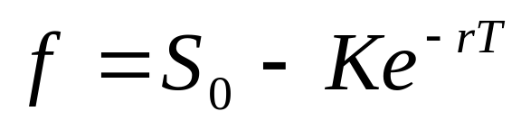
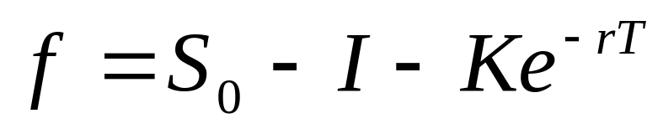
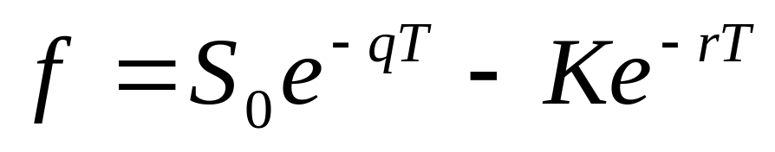
Valuing forward contracts
When the underlying asset provides no income:
When the underlying asset provides a known dollar income:
When the underlying asset provides a known yield:

Slide 34
Forward vs Futures Values
When a futures price changes, the gain or loss on a futures contract is calculated as the change in the futures price multiplied by the size of the position. This gain/loss is realized almost immediately because of the way futures contracts are settled daily.
When a forward price changes, the gain or loss is the present value of the change in the forward price multiplied by the size of the position.

Slide 35
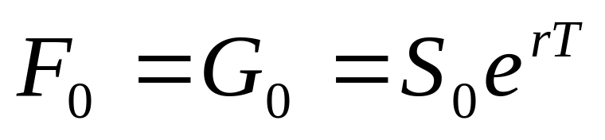
  Are forward prices and futures prices equal?
  Appendix p.126: when interest rates are constant, forward and futures prices are equal.
  Forward and futures prices are usually assumed to be the same. When interest rates are uncertain they are, in theory, slightly different.
Ex: Suppose a forward contract maturing at time T. The current forward price is G₀.
A futures contract on the same underlying asset matures at time T. The current futures price is F0.

Slide 36
  Futures on stock indices
Stock indices can be viewed as an investment asset paying a dividend yield
The futures price and spot price relationship is therefore
F₀ = S₀ e^{(r–q )T}
where q is the dividend yield on the portfolio represented by the index during life of contract

Slide 37
Ex: Consider a 3-month futures contract on the S&P 500. Suppose that stocks underlying the index provide a dividend yield of 1% per annum. The current value of the index is 1,300. The continuously compounded risk-free interest rate if 5% per annum. Calculate the futures price.
S0 = 1300, r = 0.05, q = 0.01, T = 0.25

Slide 38
Index Arbitrage
Index arbitrage involves simultaneous trades in futures and many different stocks
Very often a computer is used to generate the trades
If F₀ > S₀e^{(r-q)T}, profits can be made by buying stocks underlying the index at the spot price and shorting futures contract
If F₀ < S₀e^{(r-q)T} profits can be made by shorting the stocks underlying the index and taking a long position in futures contracts..

Slide 39
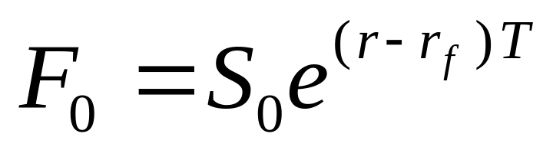
Futures and Forwards on Currencies
A foreign currency is analogous to a security providing a dividend yield. The continuous dividend yield is the foreign risk-free interest rate.
S₀ = the current spot price in dollars of one unit of foreign currency.
F₀ = the forward or futures price in dollars of one unit of foreign currency.
r = the dollar risk-free rate.
r_{f} = the foreign risk-free rate.
The relationship between spot and futures/forward prices:

Slide 40
Foreign Exchange Quotes
Futures exchange rates are quoted as the number of USD per unit of the foreign currency
Forward exchange rates are quoted in the same way as spot exchange rates. This means that GBP, EUR, AUD, and NZD are USD per unit of foreign currency. Other currencies (e.g., CAD and JPY) are quoted as units of the foreign currency per USD.
Notes:
17

Slide 41
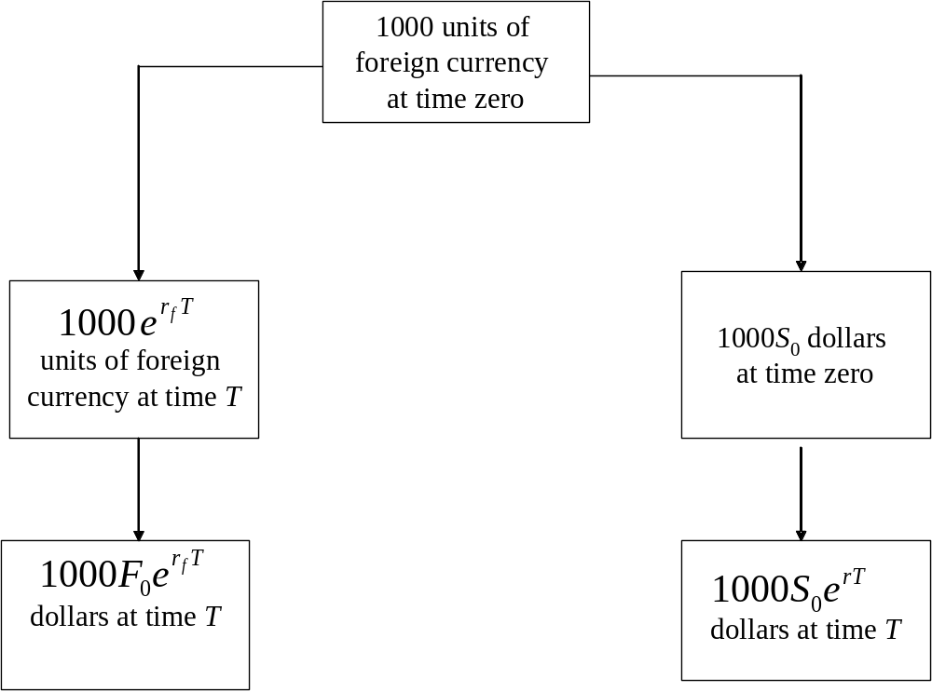
Why the Relation Must Be True Figure 5.1, page 113

Slide 42
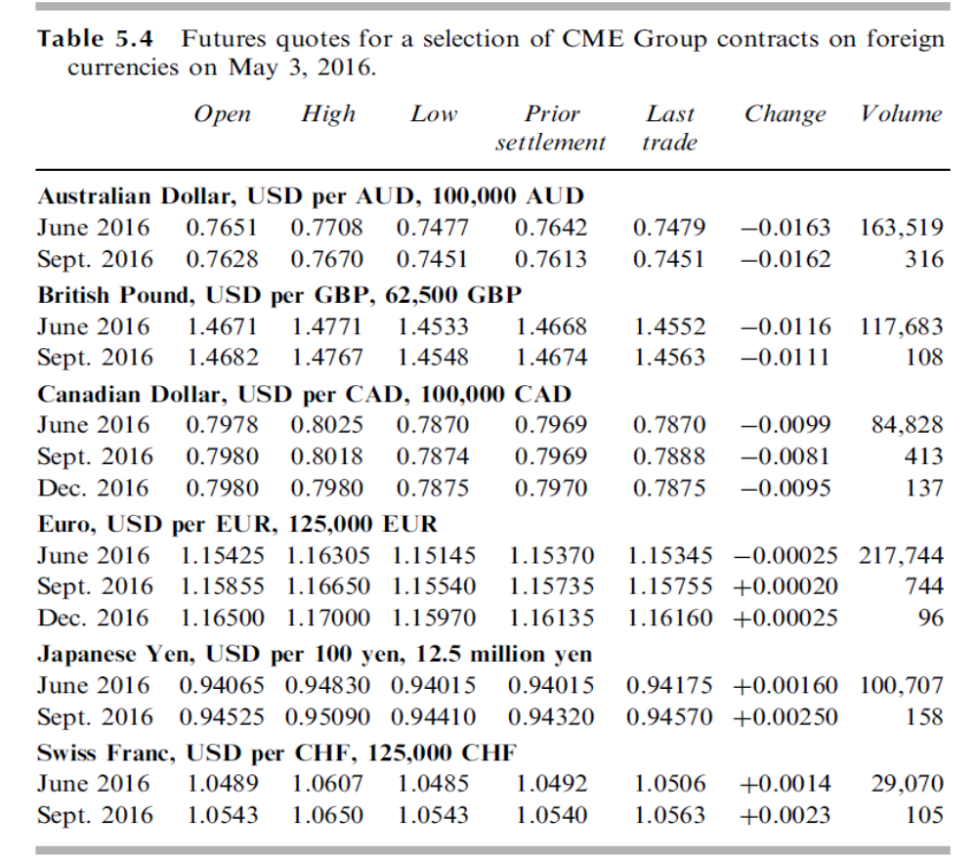


Slide 43
Ex: Suppose that the 2-year interest rate in Australia and the US are 5% and 7%, respectively. The spot exchange rate between AUD and USD is 0.6200 USD per AUD. Calculate the 2-year forward exchange rate. Suppose that the 2 year forward exchange rate is 0.6300. What should an arbitrageur do?

Slide 44
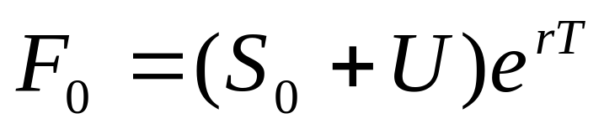
  Futures on commodities
Consider futures on commodities that are investments assets (gold, silver).
Gold and silver provide income to the holder and also have storage costs.
U= present value of all the storage costs, net of income, during the life of a forward contract.
Forward/ Futures price:

Slide 45
Ex: Consider a 1-year futures contract on an investment asset that provides no income. It costs $2 per unit to store the asset, with the payment being made at the end of the year. The spot price is $450 per unit and the risk-free rate is 7% per annum for all maturities. Calculate the futures price.

Slide 46
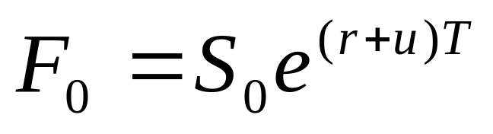
If the storage costs net of income incurred at any time are proportional to the price of the commodity, they can be treated as negative yield.
If the above equations do not hold, what should an arbitrageur do?

Slide 47
Futures on Consumption Assets
F₀ ≤ S₀ e^{(r+u )T}
where u is the storage cost per unit time as a percent of the asset value.
Alternatively,
F₀ ≤ (S₀+U )e^{rT}
where U is the present value of the storage costs.

Slide 48
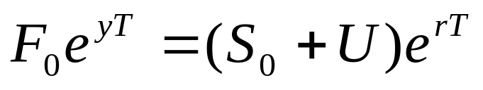
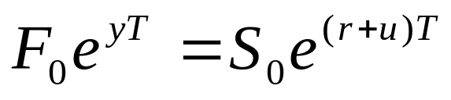
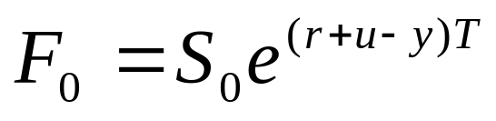
Convenience yield
The users of a consumption commodity may feel that ownership of the physical commodity provides benefits that are not obtained by holders of futures contracts. The benefits from holding the physical asset are referred to as the convenience yield provided by the commodity.
Or

Slide 49
The Cost of Carry
The cost of carry, c, is the storage cost plus the interest costs less the income earned
For an investment asset F₀ = S₀e^{cT}
For a consumption asset F₀ ≤ S₀e^{cT}
The convenience yield on the consumption asset, y, is defined so that F₀ = S₀ e^{(c–y )T}

Slide 50
Normal Backwardation and Contango
Normal Backwardation: when the futures price is below the expected future spot price.
Contango: when the futures price is above the expected future spot price.

Slide 51
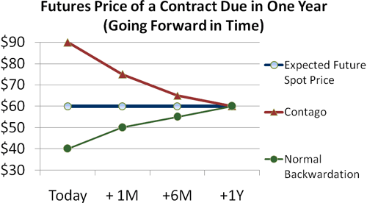
Normal Backwardation và Contango

Slide 52
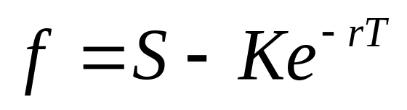
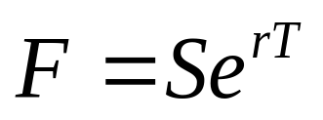
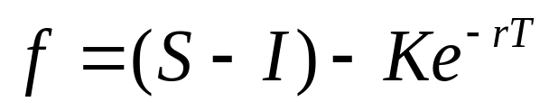
Value of a forward contract
 | Value of a forward | Forward price
No income
Known income I =PV(Income) |  | F=(S – I)e^{rT}
Known yield q | f =S e^{-qT} – K e^{-rT} | F = S e^{(r-q)T}
Commodities | f=Se^{(u-y)T}- Ke^{-rT} | F=Se^{(r+u-y)T}

Slide 53
Problems
5. A stock index currently stands at 350. The risk-free interest rate is 12% per annum (with continuous compounding). The dividend yield on the index is 4% per annum. What should the futures price for a 4-month contract be?
6. The risk-free rate of interest is 7% per annum (with continuous compounding), and the dividend yield on a stock index is 3.2% per annum. The current value of the index is 150. What is the 6-month futures price?

Slide 54
7. A 1-year long forward contract on a non-dividend-paying stock is entered into when the stock price is $40 and the risk-free rate of interest is 10% per annum with continuous compounding.
What are the forward price and the initial value of the forward contract?
Six months later, the price of the stock is $45 and the risk-free interest rate is still 10%. What are the forward price and the value of the forward contract?

Slide 55
8. A stock is expected to pay a dividend of $1 per share in 2 months and in 5 months. The stock price is $50 and the risk-free rate of interest is 8% per annum with continuous compounding for all maturities. An investor has taken a short position in a 6-month forward contract on the stock.
What are the forward price and the initial value of the forward contract?
Three months later, the price of the stock is $48 and the risk-free rate of interest is still 8% per annum. What are the forward price and the value of the short position in the forward contract?

Slide 56
9. The risk-free interest is 7% per annum with continuous compounding. The dividend yield on a stock index is 4% per annum. The current value of the index is $400. The futures price for a contract deliverable in 4 months is 405. What arbitrage opportunities does this create?
10. The 2-month interest rate in Switzerland and the US are, respectively, 2% and 5% per annum with continuous compounding. The spot price of the Swiss franc (CHF) is $0.8000. The futures price for a contract deliverable in 2 months is $0.8100. What arbitrage opportunities does this create?

Slide 57
11. The spot price of silver is $9 per ounce. The storage costs are $0.24 per ounce per year payable quarterly in advance. The interest rates are 10% per annum for all maturities. Calculate the theoretical futures price of silver for delivery in 9 months.
If the actual futures price is $13 per ounce. What arbitrage opportunities does this create?

Slide 58
12. A trader owns gold as part of a long-term investment portfolio. The trader can buy gold for $550 per ounce and sell it for $549 per ounce. The trader can borrow funds at 6% per year and invest funds at 5.5% per year (both interest rates are expressed with continuous compounding).
For what range of 1-year forward prices of gold does the trader have no arbitrage opportunities? Assume there is no bid-offer spread for forward prices.

Slide 59
13. A bank offers a corporate client a choice between borrowing cash at 11% per annum and borrowing gold at 2% per annum. (If gold is borrowed, interest must be repaid in gold. Thus, 100 ounces borrowed today would require 102 ounces to be repaid in 1 year.) The risk-free interest rate is 9.25% per annum, and storage costs are 0.5% per annum. Discuss whether the rate of interest on the gold is too high or too low in relation to the rate of interest on the cash loan. The interest rates on the two loans are expressed with annual compounding. The risk-free interest rate and storage costs are expressed with continuous compounding.

Slide 60
15. An investor holds title to an asset worth $ 125.72. To raise money for an unrelated purpose, the investor plans to sell the asset in nine months. The investor is concerned about uncertainty in the price of the asset at that time. The investor learns about the advantages of using forward contracts to manage this risk and enter s into such a contract to sell the asset in nine months. The risk-free interest rate is 5.625% for all maturities
Determine the appropriate price the investor could receive in nine months by means of the forward contract.

Slide 61
B. Suppose the counterparty to the forward contract is willing to engage in such a contract at a forward price of $140. Explain what type of transaction the investor could execute to take advantage of the situation. Calculate rate of return (annualized) and explain why the transaction is attractive.
C. Suppose the forward contract is entered into at the price you computed in Part A. Two months later, the price of the asset in $118.875. The investor would like to evaluate her position with respect to any gain or loss accrued on the forward contract. Determine the market value of the forward contract at this point of time from the perspective of the investor in Part A.

Slide 62
D. Determine the value of the forward contract at expiration assuming the contract is entered into at the price you computed in part A an the price of the underlying asset is $123.50 at expiration. Explain how the investor did on the overall position of both the asset and the forward contract in terms of the rate of return.

